Slide 1
Managing Application Resources

Slide 2
Overview
Understand what resources are and how to use them in our applications
Set simple resource values using the Android IDE
Work with different types of resources
Work with and define Android application screen elements and layouts

Slide 3
What Are Resources?
All Android applications are composed of two things:
  Functionality (code instructions)
    Functionality is the code that determines how your application behaves
    This includes any algorithms that make the application run
  Data (resources)
    Resources include text strings, styles and themes, dimensions, images and icons, audio files, videos, and other data used by the application

Slide 4
Storing Application Resources
Android resource files are stored separately from the .java class files in the Android project
  Most common resource types are stored in XML
  You can also store raw data files and graphics as resources
  Resources are organized in a strict directory hierarchy
  All resources must be stored under the /res project directory in specially named subdirectories that must be lowercase

Slide 5
Storing Application Resources
Resource Subdirectory | Purpose
/res/drawable-*/ | Graphics resources
/res/layout/ | User interface resources
/res/menu/ | Menu resources for showing options or actions in your activities
/res/values/ | Simple data such as strings, styles and themes, and dimensions
/res/values-sw*/ | Dimension resources for overriding defaults
/res/values-v*/ | Style and theme resources for newer API customizations
Notes:
Different resource types are stored in different directories.
The resource subdirectories generated when you create an Android project are shown in this table with some default Android resource directories.

Slide 6
Storing Application Resource
Each resource type corresponds to a specific resource subdirectory name; for example:
    All graphics are stored under the /res/drawable directory structure
Resources can be further organized in a variety of ways using even more specially named directory qualifiers; for example:
    /res/drawable-hdpi stores graphics for high-density screens
    /res/drawable-ldpi stores graphics for low-density screens
    /res/drawable-mdpi stores graphics for medium-density screens
    /res/drawable-xhdpi stores graphics for extra-high-density screens
    /res/drawable-xxhdpi stores graphics for extra-extra-high-density screens
  If you had a graphic resource that was shared by all screens, you would simply store that resource in the /res/drawable directory

Slide 7
Storing Application Resources
The Android IDE makes adding resources simple
  It automatically detects new resources when you add them to the appropriate project resource subdirectory under /res
  These resources are compiled, resulting in the generation of the R.java source file
    This file enables you to access your resources programmatically

Slide 8
Resource Value Types
Android applications rely on many different types of resources:
  Text strings, graphics, color schemes, and other resources for user interface design
These resources are stored in the /res directory of your Android project in a strict (but reasonably flexible) set of directories and files
All resource filenames must be lowercase and simple
  Must use letters, numbers, and underscores only

Slide 9
Resource Value Types
Resource Type | Directory
Property animations | /res/animator/
Tweened animations | /res/anim/
Color state lists | /res/color/
Drawables | /res/drawable/
Layouts | /res/layout/
Menus | /res/menu/
Arbitrary raw files | /res/raw/
Simple values | /res/values/
Arbitrary XML | /res/xml
Notes:
The resource types supported by the Android SDK and the directory where they are stored within the project are shown in this table.

Slide 10
Storing Primitive Resource Types
Simple resource value types, such as strings, colors, dimensions, and other primitives, are stored under the /res/values project directory in XML files
Each resource file under the /res/values directory should begin with the following XML header:
    <?xml version="1.0" encoding="utf-8"?>
Next comes the root node <resources> followed by the specific resource element types such as <string> or <color>
Each resource is defined using a different element name
Primitive resource types simply have a unique name and a value, like this color resource:
<color name="myFavoriteShadeOfRed">#800000</color>

Slide 11
Tip
Although the XML filenames are arbitrary, the best practice is to store resources in separate files to reflect their types, such as strings.xml, colors.xml, and so on
However, there’s nothing stopping developers from creating multiple resource files for a given type, such as two separate XML files called bright_colors.xml and muted_colors.xml

Slide 12
Storing Graphics and Files
You can also store numerous other types of resources, such as graphics, arbitrary XML files, and raw files
  These types of resources are stored in specially named directories according to their type; for example:
    Graphics are stored in the /res/drawable directory structure
    XML files can be stored in the /res/xml directory
    Raw files can be stored in the /res/raw directory
Make sure you name resource files appropriately because the resource name for graphics and files is derived from the filename of the specific resource; for example:
    A file called flag.png in the /res/drawable directory is given the name R.drawable.flag

Slide 13
Storing Other Resource Types
All other resource types—be they tweened animation sequences, color state lists, or menus—are stored in special XML formats in various directories
  Each resource must be uniquely named

Slide 14
Understanding How Resources Are Resolved
The Android platform has a robust mechanism for loading the appropriate resources at runtime
  You can organize Android project resources based on more than a dozen different criteria
  Resources stored at the directory hierarchy are considered default resources
  You can also supply special versions of your resources to load instead of the defaults
    These specialized resources are called alternative resources
    Some common reasons that developers use alternative resources:
      Internationalization
      Localization
      Accommodating different device screens and orientations

Slide 15
Understanding How Resources Are Resolved
Default and alternative resources are best illustrated by example
  Let’s presume that we have a simple application with string, graphics, and layout resources
  In this application, the resources are stored in the top-level resource directories; for example:
    /res/values/strings.xml
    /res/drawable/mylogo.png
    /res/layout/main.xml
  No matter what Android device you run this application on, the same resource data is loaded and used
  This application uses only default resources
But what if we want our application to use different graphics sizes based on the screen density?
  We could use alternative resources to do this

Slide 16
Understanding How Resources Are Resolved
Low-density screens
  /res/drawable-ldpi/mylogo.png
Medium-density screens
  /res/drawable-mdpi/mylogo.png
High-density screens
  /res/drawable-hdpi/mylogo.png
Extra-high-density screens
  /res/drawable-xhdpi/mylogo.png
Extra-extra-high-density screens
  /res/drawable-xxhdpi/mylogo.png
Layout loaded in portrait mode
  /res/layout-port/main.xml
Layout loaded in landscape mode
  /res/layout-land/main.xml

Slide 17
Accessing Resources Programmatically
Developers access specific application resources using the R.java class file and its subclasses
These are automatically generated when you add resources to your project if you use the Android IDE
You can refer to any resource identifier in your project by its name
  Which is why it must be unique
  For example, a string resource named strHello defined within the resource file called /res/values/strings.xml is accessed in the code as follows:
    R.string.strHello
Notes:
R.string.strHello
This variable is not the actual data associated with the string named hello. Instead, you use this resource identifier to retrieve the resource of that type (which happens to be string) from the project resources associated with the application.

Slide 18
Accessing Resources Programmatically
To access resources programmatically:
  First retrieve the resource instance for your application Context (android.content.Context)
    In this case, the Activity class extends Context
  Then use the resource instance to get the appropriate kind of resource you want
    The Resources class android.content.res.Resources has helper methods for handling every kind of resource
A simple way to retrieve the string text is to call the getString() method of the Resources class, like this:
  String myString = getResources().getString(R.string.strHello);

Slide 19
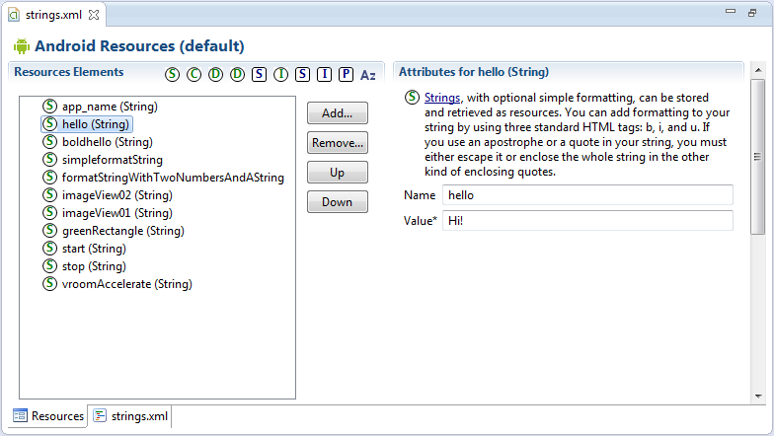
Setting Simple Resource Values Using the Android IDE
Notes:
Using the Android project included with the book called ResourceRoundup, your strings.xml resource file, found in the directory path /res/values/strings.xml, should look something like what we see here.
There are two tabs at the bottom of this pane. The Resources tab provides a friendly method to easily insert primitive resource types such as strings, colors, and dimension resources. The strings.xml tab shows the raw XML resource file you are creating. Sometimes editing the XML file manually is much faster, especially if you add a number of new resources.

Slide 20
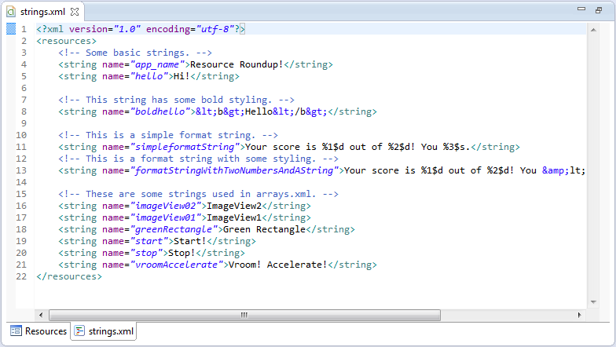
Setting Simple Resource Values Using the Android IDE
Notes:
After clicking the strings.xml tab, we should see the XML view.

Slide 21
Setting Simple Resource Values Using the Android IDE
To add some resources, use the Add button on the Resources tab
Let’s create the following resources:
  A color resource named prettyTextColor with a value of #ff0000
  A dimension resource named textPointSize with a value of 14pt
  A drawable resource named redDrawable with a value of #F00

Slide 22
Setting Simple Resource Values Using the Android IDE
    <?xml version="1.0" encoding="utf-8"?>
    <resources>
    <string name="app_name">ResourceRoundup</string>
    <string
    name="hello">Hello World,
    ResourceRoundupActivity</string>
    <color name="prettyTextColor">#ff0000</color>
    <dimen name="textPointSize">14pt</dimen>
    <drawable name="redDrawable">#F00</drawable>
    </resources>
Notes:
Now you have several resources of various types in your strings.xml resource file. If you switch back to the XML view, you see that the Android IDE resource editor has added the appropriate XML elements to your file, which now should look something like the XML listing here.
Save the strings.xml resource file. The Android IDE automatically generates the R.java file in your project, with the appropriate resource IDs, which enable you to programmatically access your resources after they are compiled into the project.

Slide 23
Setting Simple Resource Values Using the Android IDE
String myString = getResources().getString(R.string.hello);
int myColor =
getResources().getColor(R.color.prettyTextColor);
float myDimen =
getResources().getDimension(R.dimen.textPointSize);
ColorDrawable myDraw = ColorDrawable)getResources().
getDrawable(R.drawable.redDrawable);
Notes:
Now you are free to use these resources in your code. If you navigate to your ResourceRoundupActivity.java source file, you can add some lines to retrieve your resources and work with them, like this.

Slide 24
Setting Simple Resource Values Using the Android IDE
<?xml version="1.0" encoding="utf-8"?>
<resources>
<string name="app_name">Use Some Resources</string>
<string name="hello">Hello World,
UseSomeResources</string>
<color name="prettyTextColor">#ff0000</color>
<dimen name="textPointSize">14pt</dimen>
<drawable name="redDrawable">#F00</drawable>
<string-array name="flavors">
<item>Vanilla</item>
<item>Chocolate</item>
<item>Strawberry</item>
</string-array>
</resources>
Notes:
Some resource types, such as string arrays, are more easily added to resource files by editing the XML by hand. For example, if we go back to the strings.xml file and choose the strings.xml tab, we can add a string array to our resource listing by adding the following XML element.

Slide 25
Setting Simple Resource Values Using the Android IDE
Save the strings.xml file
The string array named flavors is available in your source file R.java, so you can use it programmatically in ResourceRoundupActivity.java, like this:
String[] aFlavors = getResources().getStringArray(R.array.flavors);

Slide 26
Setting Simple Resource Values Using the Android IDE
It is a common practice to store different types of resources in different files; for example:
  You might store the strings in /res/values/strings.xml but store the prettyTextColor color resource in /res/values/colors.xml and the textPointSize dimension resource in /res/values/dimens.xml
Reorganizing where you keep your resources in the resource directory hierarchy does not change the names of the resources or the code used earlier to access them programmatically

Slide 27
Working with Different Types of Resources
For each type of resource, you learn what types of values can be stored and in what format
Some resource types, such as string and color, are well supported with the Android IDE resource editor
Others, such as Animation sequences, are more easily managed by editing the XML files directly

Slide 28
Working with String Resources
String resources are among the simplest resource types available
String resources might show text labels on form views and for help text
By default, the application name is stored as a string resource
String resources are defined in XML under the /res/values project directory and compiled into the application package at build time
All strings with apostrophes or single straight quotes need to be escaped or wrapped in double straight quotes

Slide 29
Working with String Resource
String Resource Value | Displays as
Hello, World | Hello, World
"User's Full Name:" | User’s Full Name:
User\'s Full Name: | User’s Full Name:
She said, \"Hi.\" | She said, “Hi.”
She\'s busy but she did say, \"Hi.\" | She’s busy but she did say, “Hi.”
Notes:
Some examples of well-formatted string values are shown here.

Slide 30
Working with String Resources
You can edit the strings.xml file using the Resources tab, or you can edit the XML directly by clicking the file and choosing the strings.xml tab
After you save the file, the resource identifiers are automatically added to your R.java class file
String values are appropriately tagged with the <string> tag and represent a name/value pair
The name attribute is how you refer to the specific string programmatically, so name these resources wisely
Here’s an example of the string resource file /res/values/strings.xml:
  <?xml version="1.0" encoding="utf-8"?>
  <resources>
  <string name="app_name">Resource Viewer</string>
  <string name="test_string">Testing 1,2,3</string>
  <string name="test_string2">Testing 4,5,6</string>
  </resources>

Slide 31
Bold, Italic, and Underlined Strings
You can also add three HTML-style attributes to string resources
These are bold, italic, and underlining
You specify the styling using the <b>, <i>, and <u> tags, respectively
For example:
  <string name="txt">
    <b>Bold</b>,<i>Italic</i>,<u>Line</u>
  </string>

Slide 32
Using String Resources as Format Strings
You can create format strings, but you need to escape all bold, italic, and underlining tags
For example, this text shows a score and the “win” or “lose” string:
    <string name="winLose">
      Score: %1$d of %2$d! You %3$s.
    </string>
If you want to include bold, italic, or underlining in this format string, you need to escape the format tags
For example, if you want to italicize the “win” or “lose” string at the end:
    <string name="winLoseStyled">
      Score: %1$d of %2$d! You &lt;i&gt;%3$s&lt;/i&gt;.
    </string>
This is standard XML escaping; after the standard set of XML escape characters is parsed, the string is interpreted with the formatting tags
You also need to escape single quotes (' is &apos;), double quotes (" is &quot;), and ampersands (& is &amp;)

Slide 33
Using String Resources Programmatically
There are two primary ways in which you can access a string resource
The following code accesses your application’s string resource named hello, returning only the string
    String myStrHello = getResources().getString(R.string.hello);
All HTML-style attributes (bold, italic, and underlining) are stripped from the string
You can also access the string and preserve the formatting by using this other method:
    CharSequence myBoldStr = getResources().getText(R.string.boldhello);

Slide 34
Using String Resources Programmatically
  String mySimpleWinString;
  mySimpleWinString =
  getResources().getString(R.string.winLose);
  String escapedWin = TextUtils.htmlEncode(mySimpleWinString);
  String resultText = String.format(mySimpleWinString, 5, 5, escapedWin);
The resulting text in the resultText variable is
  Score: 5 of 5! You Won
To load a format String, you need to make sure any format variables are properly escaped.
One way you can do this is by using the htmlEncode() method
Notes:
To load a format string, you need to make sure any format variables are properly escaped. One way you can do this is by using the htmlEncode() method of the TextUtils (android.text.TextUtils) class.

Slide 35
Using String Resources Programmatically
  String myStyledWinString;
  myStyledWinString =
  getResources().getString(R.string.winLoseStyled);
  String escapedWin =
  TextUtils.htmlEncode(myStyledWinString);
  String resultText =
  String.format(myStyledWinString, 5, 5, escapedWin);
  CharSequence styledResults = Html.fromHtml(resultText);
The resulting text in the styledResults variable is
  Score: 5 of 5! You <i>Won</i>
Notes:
If you have styling in this format string like the preceding string resource winLoseStyled, you need to take a few more steps to handle the escaped italic tags. For this, you might want to use the fromHtml() method of the Html class (android.text.Html), as shown here.
This variable, styledResults, can then be used in user interface controls such as TextView objects, where styled text is displayed correctly.

Slide 36
Working with Quantity Strings
A special resource type called <plurals> can be used to define strings that are useful for changing a word’s grammatical quantity form
Here is an example string resource file with the resource path of res/values/strings.xml that defines two different quantity forms of a particular animal name that changes based on the context:
<resources>
<plurals name="quantityOfGeese">
<item quantity="one">You caught a goose!</item>
<item quantity="other">You caught %d geese</item>
</plurals>
</resources>

Slide 37
Working with Quantity Strings
The singular form for this particular animal is goose and the plural form is geese. The %d value is used so we can display the exact quantity of geese to the user
To work with pluralized resources in your code, the method getQuantityString() can be used to retrieve a plural string resource:
  int quantity = getQuantityOfGeese();
  Resources plurals = getResources();
  String geeseFound = plurals.getQuantityString(
  R.plurals.quantityOfGeese, quantity, quantity);
Notes:
getQuantityString() takes three variables. The first is the plural resource; the second is the quantity value, which is used to tell the application which grammatical form of the word to display; and the third value is defined only when the actual quantity is to be displayed to the user, substituting %d with the actual integer value.
When internationalizing your application, managing the translation of words properly and accounting for quantity in a particular language is very important. Not all languages follow the same rules for quantity, so in order to make this process manageable, using plural resource string files will definitely help.
You are able to define many different grammatical forms for a particular word. To define more than one quantity form of a given word in your string resource file, you simply specify more than one <item> element and provide a value for the quantity attribute for that particular <item> denoting the word’s quantity.

Slide 38
Working with Quantity Strings
Value | Description
zero | Used for languages that have words with a zero quantity form
one | Used for languages that have words with a singular quantity form
two | Used for languages that have words for specifying two
few | Used for languages that have words for specifying a small quantity batch
many | Used for languages that have words for specifying a large quantity batch
other | Used for languages that have words that do not have a quantity form
Notes:
Here are the values that you can use to specify an <item>’s quantity attribute.

Slide 39
Working with String Arrays
You can specify lists of strings in resource files
  This is a good way to store menu options and drop-down list values
  String arrays are defined in XML under the /res/values project directory
  They are compiled into the application package at build time
String arrays are appropriately tagged with the <string-array> tag
  Usually include a number of <item> child tags
    One for each string in the array

Slide 40
Working with String Arrays
      <?xml version="1.0" encoding="utf-8"?>
      <resources>
      <string-array name="flavors">
      <item>Vanilla</item>
      <item>Chocolate</item>
      <item>Strawberry</item>
      <item>Coffee</item>
      <item>Sherbet</item>
      </string-array>
      <string-array name="soups">
      <item>Vegetable minestrone</item>
      <item>New England clam chowder</item>
      <item>Organic chicken noodle</item>
      </string-array>
      </resources>
Notes:
Here’s an example of a simple array resource file /res/values/arrays.xml.

Slide 41
Working with String Array
Accessing string array resources is easy
The method getStringArray() retrieves a string array from a resource file, in this case one named flavors:
String[] aFlavors = getResources().getStringArray(R.array.flavors);

Slide 42
Working with Boolean Resources
Other primitive types are supported by the Android resource hierarchy
Boolean resources can be used to store information about application game preferences and default values
  These are defined in XML under the /res/values project directory and compiled into the application package at build time

Slide 43
Defining Boolean Resources in XML
Boolean values are appropriately tagged with the <bool> tag and represent a name/value pair
The name attribute is how you refer to the specific Boolean value programmatically, so name these resources wisely
Here’s an example of the Boolean resource file /res/values/bools.xml:
<?xml version="1.0" encoding="utf-8"?>
<resources>
<bool name="bOnePlusOneEqualsTwo">true</bool>
<bool
name="bAdvancedFeaturesEnabled">false</bool>
</resources>

Slide 44
Using Boolean Resources Programmatically
To use a Boolean resource in code
  Load it using the getBoolean() method of the Resources class
To access your application’s Boolean resource named bAdvancedFeaturesEnabled:
boolean bAdvancedMode = getResources()
.getBoolean(R.bool.bAdvancedFeaturesEnabled);

Slide 45
Working with Integer Resources
In addition to strings and Boolean values, you can also store integers as resources
Integer resources are defined in XML under the /res/values project directory
They are compiled into the application package at build time

Slide 46
Defining Integer Resources in XML
Integer values are appropriately tagged with the <integer> tag and represent a name/value pair
  The name attribute is how you refer to the specific integer programmatically, so name these resources wisely
Here’s an example of the integer resource file /res/values/nums.xml:
<?xml version="1.0" encoding="utf-8"?>
<resources>
<integer name="numTimesToRepeat">25</integer>
<integer
name="startingAgeOfCharacter">3</integer>
</resources>

Slide 47
Using Integer Resources Programmatically
To use an integer resource, you must load it using the Resources class
The following code accesses your application’s integer resource named numTimesToRepeat:
int repTimes = getResources()
.getInteger(R.integer.numTimesToRepeat);
You can create integer arrays as resources using the <integer-array> tag
  Child <item> tags define one for each item in the array
You can then load the integer array using the getIntArray() method of the Resources class

Slide 48
Working with Colors
Android applications can store RGB color values
  These can be applied to screen elements
You can use these values to set the color of text or other elements, such as the screen background
Color resources are defined in XML under the /res/values project directory and compiled into the application package at build time

Slide 49
Defining Color Resources in XML
RGB color values always start with the hash symbol (#)
The alpha value can be given for transparency control
The following color formats are supported:
  #RGB (#F00 is 12-bit color, red)
  #ARGB (#8F00 is 12-bit color, red with alpha 50%)
  #RRGGBB (#FF00FF is 24-bit color, magenta)
  #AARRGGBB (#80FF00FF is 24-bit color, magenta, with alpha 50%)
Color values are appropriately tagged with the <color> tag and represent a name/value pair
Here’s an example of a simple color resource file /res/values/colors.xml:
    <?xml version="1.0" encoding="utf-8"?>
    <resources>
    <color name="background_color">#006400</color>
    <color name="text_color">#FFE4C4</color>
    </resources>

Slide 50
Using Color Resources Programmatically
The example at the beginning of the chapter accessed a color resource
Color resources are simply integers
The following example shows the method getColor() retrieving a color resource called prettyTextColor:
  int myResourceColor = getResources()
  .getColor(R.color.prettyTextColor);

Slide 51
Working with Dimensions
Many user interface layout controls, such as text controls and buttons, are drawn to specific dimensions
These dimensions can be stored as resources
Dimension values always end with a unit of measurement tag

Slide 52
Defining Dimension Resources in XML
Dimension values are tagged with the <dimen> tag and represent a name/value pair
They are defined in XML under the /res/values project directory and compiled into the application package at build time

Slide 53
Defining Dimension Resources in XML
Unit of Measurement | Description | Resource Tag Required | Example
Pixels | Actual screen pixels | px | 20px
Inches | Physical measurement | in | 1in
Millimeters | Physical measurement | mm | 1mm
Points | Common font measurement unit | pt | 14pt
Screen density– independent pixels | Pixels relative to 160dpi screen (preferable for dimension screen compatibility) | dp | 1dp
Scale-independent pixels | Best for scalable font display | sp | 14sp
Notes:
The dimension units supported are shown here.

Slide 54
Defining Dimension Resources in XML
  <?xml version="1.0" encoding="utf-8"?>
  <resources>
  <dimen name="FourteenPt">14pt</dimen>
  <dimen name="OneInch">1in</dimen>
  <dimen name="TenMillimeters">10mm</dimen>
  <dimen name="TenPixels">10px</dimen>
  </resources>
Notes:
Here’s an example of a simple dimension resource file called /res/values/dimens.xml.

Slide 55
Using Dimension Resources Programmatically
Dimension resources are simply floating-point values
The getDimension() method retrieves a dimension resource called textPointSize:
float myDimension = getResources()
.getDimension(R.dimen.textPointSize);

Slide 56
Drawable Resources
Drawable Class | Description
ShapeDrawable | A geometric shape such as a circle or rectangle
ScaleDrawable | Defines the scaling of a drawable
TransitionDrawable | Used to cross-fade between drawables
ClipDrawable | Drawable used to clip a region of a drawable
StateListDrawable | Used to define different states of a drawable such as pressed or selected
LayerDrawable | An array of drawables
BitmapDrawable | Bitmap graphics file
NinePatchDrawable | Stretchable PNG file

Slide 57
Working with Simple Drawables
You can specify simple colored rectangles by using the drawable resource type
  This can be applied to other screen elements
These drawable types are defined in specific paint colors, much as the color resources are defined

Slide 58
Defining Simple Drawable Resources in XML
Simple paintable drawable resources are defined in XML under the /res/values project directory and compiled into the application package at build time
Paintable drawable resources use the <drawable> tag and represent a name/value pair
Here’s an example of a simple drawable resource file called /res/values/drawables.xml:
    <?xml version="1.0" encoding="utf-8"?>
    <resources>
    <drawable name="red_rect">#F00</drawable>
    </resources>

Slide 59
Defining Simple Drawable Resources in XML
You can also create XML files that describe other Drawable subclasses, such as ShapeDrawable
Drawable XML definition files are stored in the /res/drawable directory within your project, along with image files
This is not the same as storing <drawable> resources, which are paintable drawables
ShapeDrawable resources are stored in the /res/values directory, as explained previously
Here’s a simple ShapeDrawable described in the file /res/drawable/red_oval.xml:
  <?xml version="1.0" encoding="utf-8"?>
  <shape xmlns:android=
  "http://schemas.android.com/apk/res/android"
  android:shape="oval">
  <solid android:color="#f00"/>
  </shape>

Slide 60
Using Simple Drawable Resources Programmatically
Drawable resources defined with <drawable> are simply rectangles of a given color, which is represented by the Drawable subclass ColorDrawable
The following code retrieves a ColorDrawable resource called redDrawable:
    ColorDrawable myDraw =
    (ColorDrawable) getResources()
    .getDrawable(R.drawable.redDrawable);

Slide 61
Working with Images
Supported Image Format | Description | Required Extension
Portable Network Graphics (PNG) | Preferred format (lossless) | .png
Nine-Patch Stretchable Graphics | Preferred format (lossless) | .9.png
Joint Photographic Experts Group (JPEG) | Acceptable format (lossy) | .jpeg, .jpg
Graphics Interchange Format (GIF) | Discouraged format | .gif
WebP (WEBP) | Android 4.0+ | .webp
Notes:
Applications often include visual elements such as icons and graphics. Android supports several image formats that can be directly included as resources for your application. These image formats are shown in this table.

Slide 62
Working with Images
These image formats are all well supported by popular graphics editors such as Adobe Photoshop, GIMP, and Microsoft Paint
The Nine-Patch Stretchable Graphics can be created from PNG files using the draw9patch tool included with the Android SDK
  Found under the /tools directory
Adding image resources to your project is easy
  Simply drag the image asset into the /res/drawable resource directory hierarchy

Slide 63
Working with Nine-Patch Stretchable Graphics
It can be handy to use stretchable graphics to allow a single graphic that can scale appropriately for different screen sizes and orientations or different lengths of text
This can save you or your designer a lot of time in creating graphics for many different screen sizes
Android supports Nine-Patch Stretchable Graphics for this purpose
  Nine-Patch graphics are PNG graphics that have patches, or areas of the image, defined to scale appropriately, instead of the entire image being scaled as one unit
  Often the center segment is transparent or a solid color for a background because it’s the stretched part
  A common use for Nine-Patch graphics is to create frames and borders
  Little more than the corners are needed, so a very small graphics file can be used to frame any size image or View control
Nine-Patch Stretchable Graphics can be created from PNG files using the draw9patch tool included with the /tools directory of the SDK

Slide 64
Using Image Resources Programmatically
Image resources are another kind of Drawable called a BitmapDrawable
Most of the time, you need only the resource ID of the image to set as an attribute on a user interface control
For example:
  If we drop the graphics file flag.png into the /res/drawable directory and add an ImageView control to the main layout, we can interact with that control programmatically in the layout by first using the findViewById() method to retrieve a control by its identifier and casting it to the proper type of control—in this case, an ImageView (android.widget.ImageView) object:
  ImageView flagImageView =
  (ImageView)findViewById(R.id.ImageView01);
  flagImageView.setImageResource(R.drawable.flag);

Slide 65
Using Image Resources Programmatically
If you want to access the BitmapDrawable (android.graphics.drawable.BitmapDrawable) object directly, you can request that resource directly using the getDrawable() method, as follows:
  BitmapDrawable bitmapFlag = (BitmapDrawable)
  getResources().getDrawable(R.drawable.flag);
  int iBitmapHeightInPixels =
  bitmapFlag.getIntrinsicHeight();
  int iBitmapWidthInPixels =
  bitmapFlag.getIntrinsicWidth();

Slide 66
Using Image Resources Programmatically
If you work with Nine-Patch graphics, the call to getDrawable() will return a NinePatchDrawable (android.graphics.drawable.NinePatchDrawable) object instead of a BitmapDrawable object:
NinePatchDrawable stretchy = (NinePatchDrawable)
getResources().getDrawable(R.drawable.pyramid);
int iStretchyHeightInPixels =
stretchy.getIntrinsicHeight();
int iStretchyWidthInPixels =
stretchy.getIntrinsicWidth();

Slide 67
Working with Color State Lists
A special resource type called <selector> can be used to define different colors or drawables to be used depending on a control’s state
For example, you could define a color state list for a Button control: gray when the button is disabled, green when it is enabled, and yellow when it is being pressed
Similarly, you could provide different drawables based on the state of an ImageButton control
The <selector> element can have one or more child <item> elements that define different colors for different states
There are quite a few attributes that you are able to define for the <item> element, and you can define one or more for supporting many different states for your View objects

Slide 68
Working with Color State Lists
Attribute | Values
color | Required attribute for specifying a hexadecimal color in one of these formats: #RGB, #ARGB, #RRGGBB, #AARRGGBB, where A is alpha, R is red, G is green, and B is blue
state_enabled | Boolean denoting whether this object is capable of receiving touch or click events, true or false
state_checked | Boolean denoting checked or unchecked, true or false
state_checkable | Boolean denoting checkable or not checkable, true or false
state_selected | Boolean denoting selected or not selected, true or false
state_focused | Boolean denoting focused or not focused, true or false
state_pressed | Boolean denoting pressed or not pressed, true or false

Slide 69
Defining a Color State List Resource
You first must create a resource file defining the various states that you want to apply to your View object
To do so, you define a color resource that contains the <selector> element and the various <item>s and attributes that you want to apply

Slide 70
Defining a Color State List Resource
<selector xmlns:android=
"http://schemas.android.com/apk/res/android">
<item android:state_disabled="true"
android:color="#C0C0C0"/>
<item android:state_enabled="true"
android:color="#00FF00"/>
<item android:state_pressed="true"
android:color="#FFFF00"/>
<item android:color="#000000"/>
</selector>
Notes:
Here is an example file named text_color.xml that resides under the resource color directory, res/color/text_color.xml.
We have defined four different state values in this file: disabled, enabled, pressed, and a default value, provided by just defining an <item> element with only a color attribute.

Slide 71
Defining a Button for Applying the State List Resource
Now that we have a color state list resource, we can apply this value to one of our View objects
Below we define a Button and set the textColor attribute to the state list resource file text_color.xml that we defined previously
  <Button
  android:layout_width="match_parent"
  android:layout_height="wrap_content"
  android:text="@string/text"
  android:textColor="@color/text_color" />

Slide 72
Working with Animation
Android supports several kinds of animation
Two of the simplest varieties are
  Frame-by-frame
    Frame-by-frame animation involves the display of a sequence of images in rapid succession
  Tweening
    Tweened animation involves applying standard graphical transformations such as rotations and fades upon a single image
The Android SDK provides some helper utilities for loading and using animation resources
Found in the android.view.animation.AnimationUtils class

Slide 73
Defining and Using Frame-by-Frame Animation Resources
Frame-by-frame is often used when the content changes from frame to frame
It can be used for complex frame transitions—much like a kid’s flip-book
To define frame-by-frame resources, take the following steps:
  Save each frame graphic as an individual drawable resource
    It may help to name your graphics sequentially, in the order in which they are displayed—for example, frame1.png, frame2.png, and so on
  Define the animation set resource in an XML file within the /res/drawable/ resource directory hierarchy
  Load, start, and stop the animation programmatically

Slide 74
Defining and Using Frame-by-Frame Animation Resources
  <?xml version="1.0" encoding="utf-8" ?>
  <animation-list xmlns:android=
  "http://schemas.android.com/apk/res/android"
  android:oneshot="false">
  <item android:drawable="@drawable/splash1"
  android:duration="500" />
  <item android:drawable="@drawable/splash2"
  android:duration="500" />
  <item android:drawable="@drawable/splash3"
  android:duration="500" />
  </animation-list>
Notes:
Here’s an example of a simple frame-by-frame animation resource file called /res/drawable/juggle.xml that defines a simple three-frame animation that takes 1.5 seconds to complete a single loop.

Slide 75
Defining and Using Frame-by-Frame Animation Resources
Frame-by-frame animation set resources defined with <animation-list> are represented by the Drawable subclass AnimationDrawable
The following code retrieves an AnimationDrawable resource called juggle:
    AnimationDrawable jugglerAnimation = (AnimationDrawable)getResources(). getDrawable(R.drawable.juggle);
After you have a valid AnimationDrawable (android.graphics.drawable.AnimationDrawable), you can assign it to a View control on the screen and start and stop animation

Slide 76
Defining and Using Tweened Animation Resources
Tweened animation features include
  Scaling
  Fading
  Rotation
  Translation
These actions can be applied simultaneously or sequentially and might use different interpolators
Tweened animation sequences are not tied to a specific graphics file, so you can write one sequence and then use it for a variety of different graphics
For example:
  You can make moon, star, and diamond graphics all pulse using a single scaling sequence, or you can make them spin using a rotate sequence

Slide 77
Defining Tweened Animation Sequence Resources in XML
Graphic animation sequences can be stored as specially formatted XML files in the /res/anim directory and are compiled into the application binary at build time
Here’s an example of a simple animation resource file called /res/anim/spin.xml that defines a simple rotate operation— rotating the target graphic counterclockwise four times in place, taking 10 seconds to complete:
    <?xml version="1.0" encoding="utf-8" ?>
    <set xmlns:android="http://schemas.android.com/apk/res/android"
    android:shareInterpolator="false">
    <rotate
    android:fromDegrees="0"
    android:toDegrees="-1440"
    android:pivotX="50%"
    android:pivotY="50%"
    android:duration="10000" />
    </set>

Slide 78
Using Tweened Sequence Resources Programmatically
If we go back to the earlier example of a BitmapDrawable, we can now include some animation simply by adding the following code to load the animation resource file spin.xml and set the animation in motion:
  ImageView flagImageView = (ImageView)findViewById(R.id.ImageView01);
  flagImageView.setImageResource(R.drawable.flag);
  ...
  Animation an = AnimationUtils.loadAnimation(this, R.anim.spin);
  flagImageView.startAnimation(an);
Now you have your graphic spinning
Notice that we loaded the animation using the base class object Animation

Slide 79
Using Tweened Sequence Resources Programmatically
You can also extract specific animation types using the subclasses that match:
  RotateAnimation
  ScaleAnimation
  TranslateAnimation
  AlphaAnimation
These are found in the android.view.animation package
There are a number of different interpolators you can use with your tweened animation sequences

Slide 80
Working with Menus
You can also include menu resources in your project files
Like animation resources, menu resources are not tied to a specific control but can be reused in any menu control
Menu resources (which are sets of individual menu items) are stored as specially formatted XML files in the /res/menu directory and are compiled into the application package at build time

Slide 81
Defining Menu Resources in XML
<menu xmlns:android=
"http://schemas.android.com/apk/res/android">
<item android:id="@+id/start"
android:title="Start!"
android:orderInCategory="1"></item>
<item android:id="@+id/stop" android:title="Stop!"
android:orderInCategory="4"></item>
<item android:id="@+id/accel"
android:title="Vroom! Accelerate!"
android:orderInCategory="2"></item>
<item android:id="@+id/decel"
android:title="Decelerate!"
android:orderInCategory="3"></item>
</menu>
Notes:
Here’s an example of a simple menu resource file called /res/menu/speed.xml that defines a short menu with four items in a specific order.

Slide 82
Using Menu Resources Programmatically
To access the preceding menu resource called /res/menu/speed.xml, simply override the method onCreateOptionsMenu() in your Activity class, returning true to cause the menu to be displayed:
    public boolean onCreateOptionsMenu(Menu menu) {
    getMenuInflater().inflate(R.menu.speed, menu);
    return true;
    }
If you run your application and press the Menu button, you see the menu
A number of other XML attributes can be assigned to menu items

Slide 83
Working with XML Files
You can include arbitrary XML resource files to your project
You should store these XML files in the /res/xml directory
They are compiled into the application package at build time
The Android SDK has a variety of packages and classes available for XML manipulation

Slide 84
Defining Raw XML Resources
Put a simple XML file in the /res/xml directory
In this case, the file my_pets.xml with the following contents can be created:
      <?xml version="1.0" encoding="utf-8"?>
      <pets>
      <pet name="Bit" type="Bunny" />
      <pet name="Nibble" type="Bunny" />
      <pet name="Stack" type="Bunny" />
      <pet name="Queue" type="Bunny" />
      <pet name="Heap" type="Bunny" />
      <pet name="Null" type="Bunny" />
      <pet name="Nigiri" type="Fish" />
      <pet name="Sashimi II" type="Fish" />
      <pet name="Kiwi" type="Lovebird" />
      </pets>

Slide 85
Using XML Resources Programmatically
Now you can access this XML file as a resource programmatically in the following manner:
    XmlResourceParser myPets =getResources().getXml(R.xml.my_pets);
You can then use the parser of your choice to parse the XML

Slide 86
Working with Raw Files
Your application can also include raw files as part of its resources
For example:
  Your application might use raw files such as audio files, video files, and other file formats not supported by the Android Asset Packaging Tool (aapt)

Slide 87
Defining Raw File Resources
All raw resource files are included in the /res/raw directory and are added to your package without further processing

Slide 88
Using Raw File Resources Programmatically
You can access raw file resources from the /res/raw resource directory and any resource from the /res/drawable directory (bitmap graphics files, anything not using the <resource> XML definition method)
Here’s one way to open a file called the_help.txt:
    InputStream iFile = getResources()
    .openRawResource(R.raw.the_help);

Slide 89
Working with Layouts
Much as Web designers use HTML, user interface designers can use XML to define Android application screen elements and layout
A layout XML resource is where many different resources come together to form the definition of an Android application screen
Layout resource files are included in the /res/layout/ directory and are compiled into the application package at build time
Layout files might include many user interface controls and define the layout for an entire screen or describe custom controls used in other layouts

Slide 90
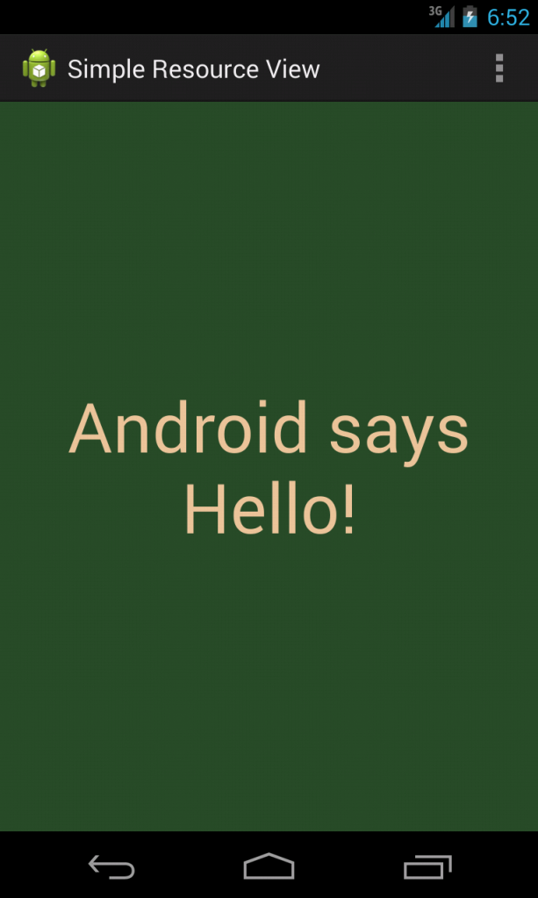
Working with Layouts
Notes:
Here’s a simple example of a layout file (/res/layout/activity_simple_resource_view.xml) that sets the screen’s background color and displays some text in the middle of the screen.

Slide 91
Working with Layouts
The activity_simple_resource_view.xml layout file that displays this screen references a number of other resources, including colors, strings, and dimension values, all of which were defined in the strings.xml, styles.xml, colors.xml, and dimens.xml resource files

Slide 92
Working with Layouts (Cont’d)
    <?xml version="1.0" encoding="utf-8"?>
    <LinearLayout xmlns:android=
    "http://schemas.android.com/apk/res/android"
    android:orientation="vertical"
    android:layout_width="fill_parent"
    android:layout_height="fill_parent"
    android:background="@color/background_color">
    <TextView android:id="@+id/TextView01"
    android:layout_width="fill_parent"
    android:layout_height="fill_parent"
    android:text="@string/test_string"
    android:textColor="@color/text_color"
    android:gravity="center"
    android:textSize="@dimen/text_size" />
    </LinearLayout>
Notes:
This layout describes all the visual elements on a screen. In this example, a LinearLayout control is used as a container for other user interface controls—here, a single TextView that displays a line of text.

Slide 93
Designing Layouts in the Android IDE
Layouts can be designed and previewed in the Android IDE using the resource editor functionality
If you click the project file /res/layout/activity_simple_resource_view.xml, you see the Layout tab, which shows a preview of the Graphical Layout, and the activity_simple_resource_view.xml tab, which shows the raw XML of the layout file

Slide 94
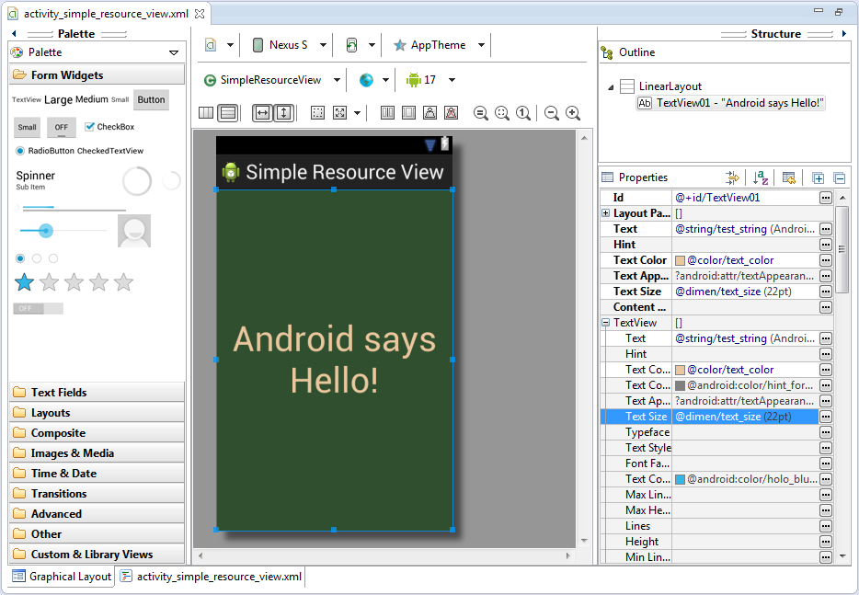
Designing Layouts in the Android IDE
Notes:
Designing a layout file using the Android IDE Graphical Layout editor.

Slide 95
Designing Layouts in the Android IDE
Like most user interface editors, the Android IDE works well for basic layout needs, enables you to create user interface controls such as TextView and Button controls easily, and enables setting the controls’ properties in the Properties pane

